Slide 1
Case study 1: Model selection for clustering
Lucas Farndale & Ke Yuan
Lucas.Farndale@glasgow.ac.uk
Ke.Yuan@glasgow.ac.uk

Slide 2
Overview
What is Model selection?
Challenges in model selection for clustering
Clustering algorithms
Colorectal Tissue Biopsy and Clustering
Your task and dataset details
Expected results
Summary

Slide 3
Model selection
Choosing the best model candidate
family of algorithms (e.g. Logistic regression, KNN)
different hyperparameters (e.g. regularisation strength, number of neighbours)
What is ‘the best model’?
Define objective (e.g. accuracy, minimise false positives, etc)
Complexity
Computability
Ease of Implementation

Slide 4

Why do we need model selection for clustering?

Slide 5
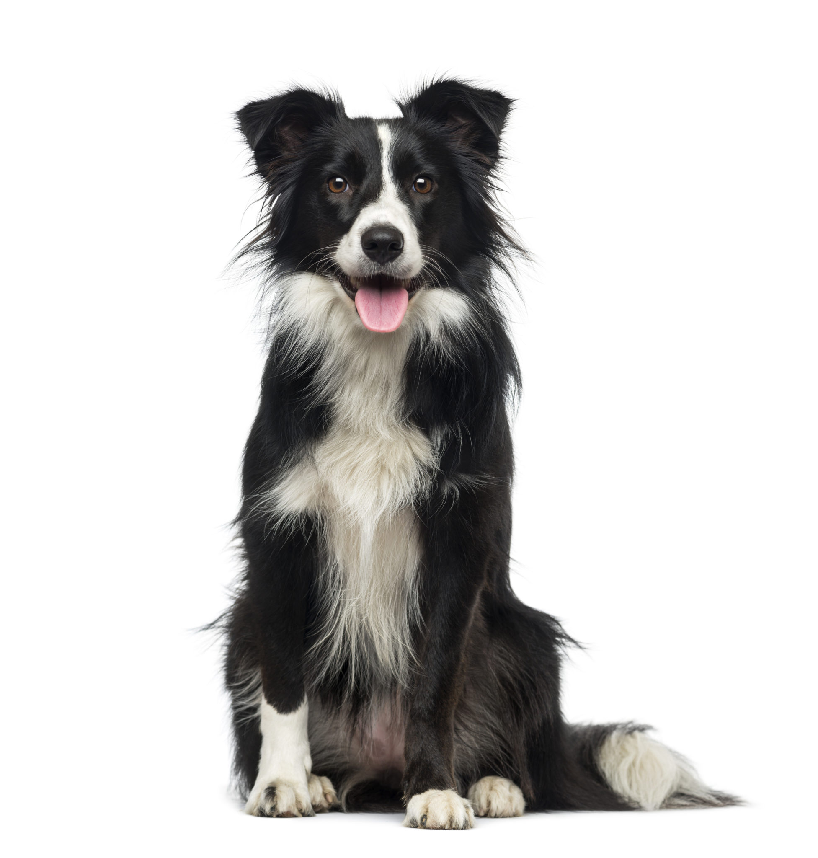
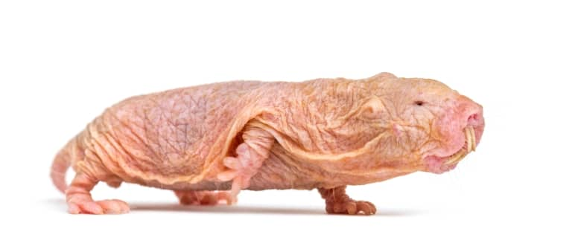
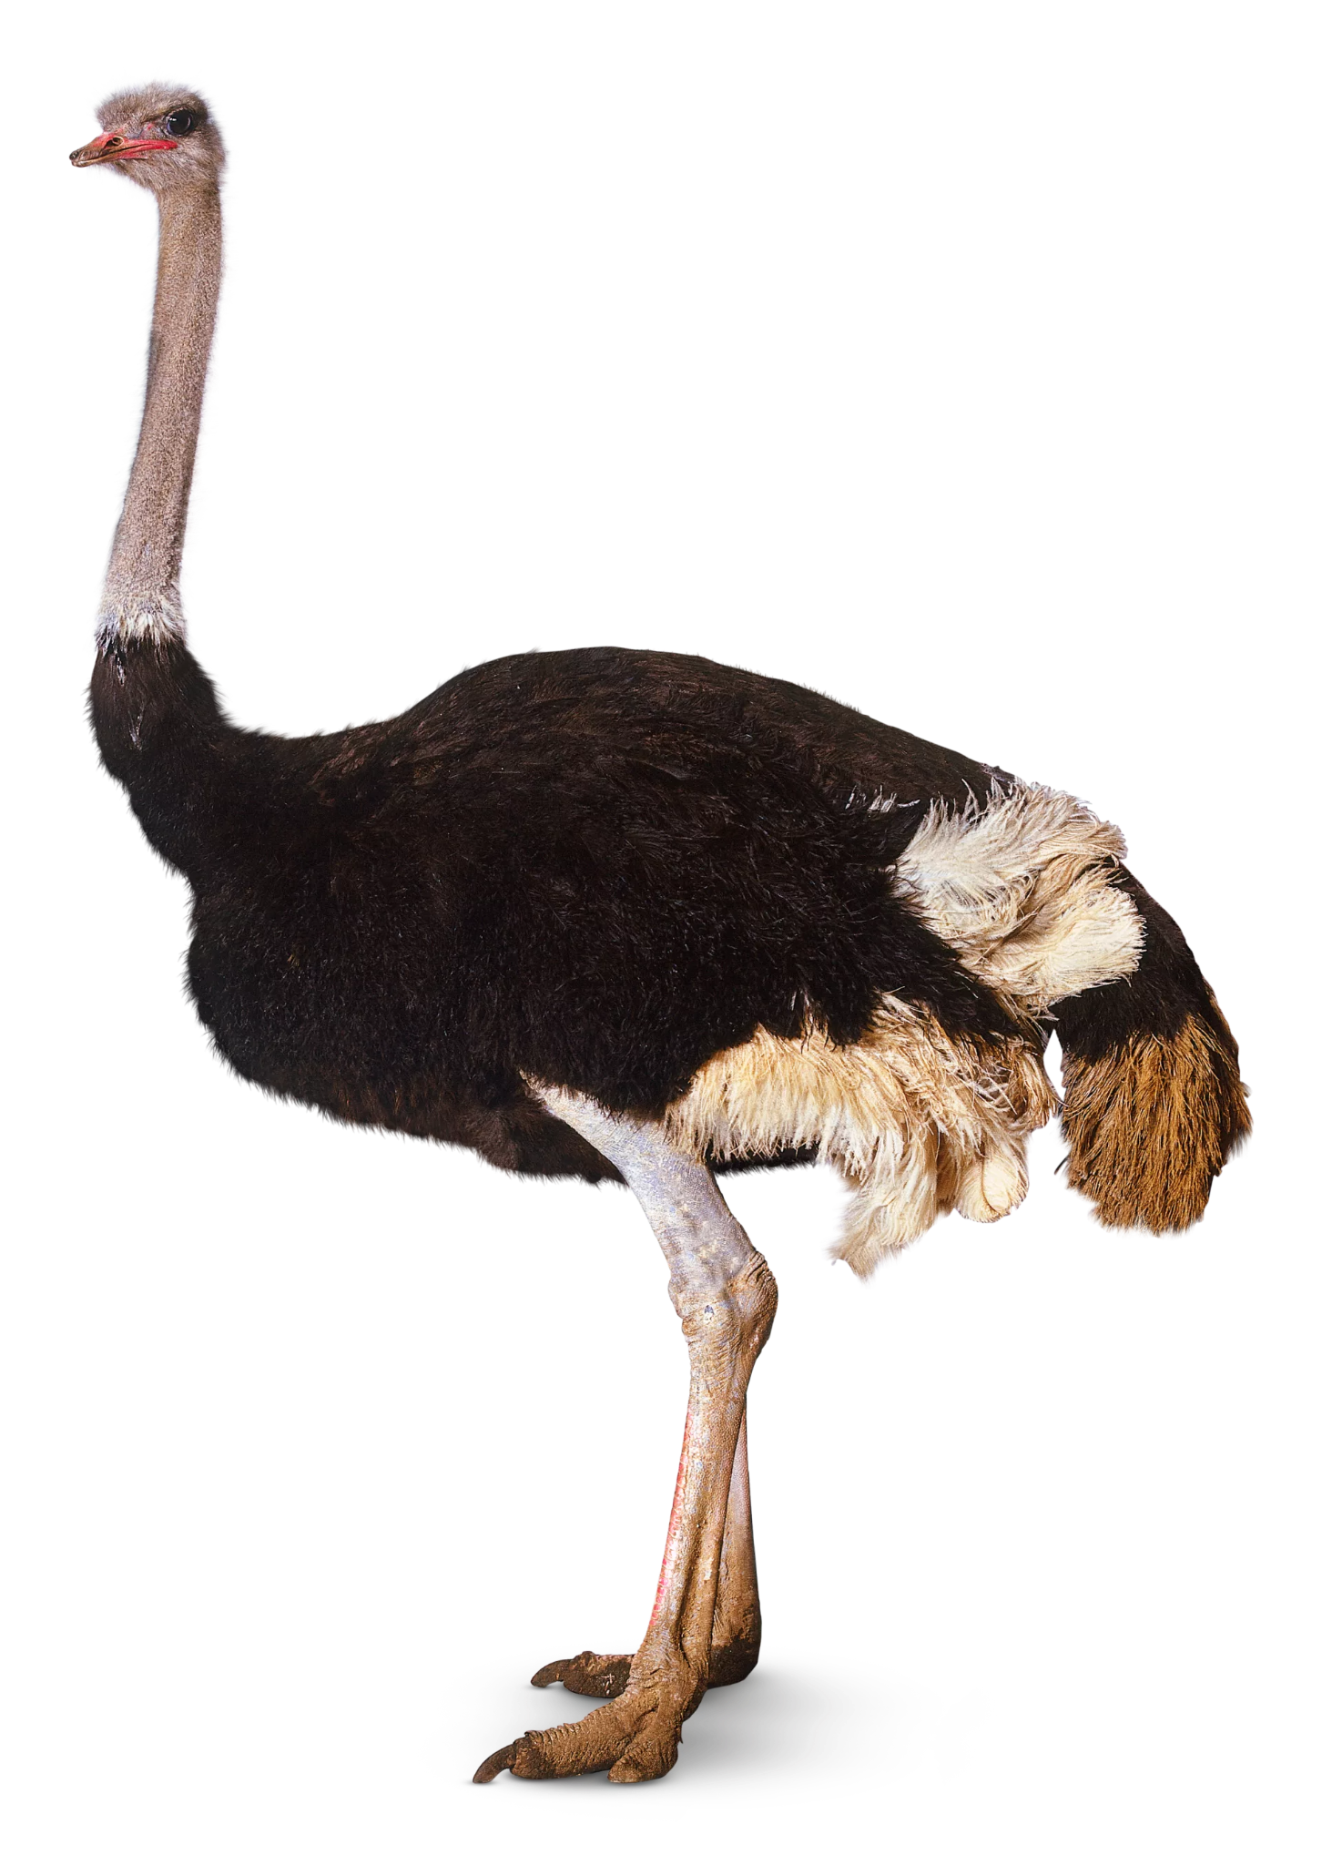
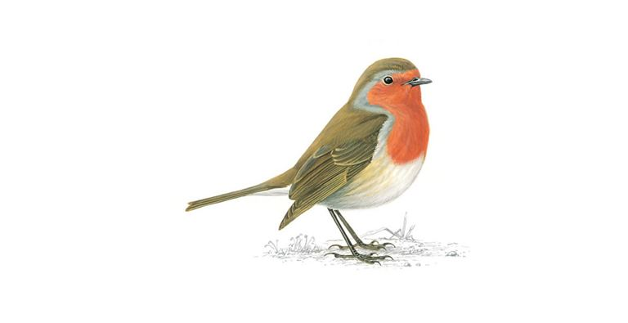

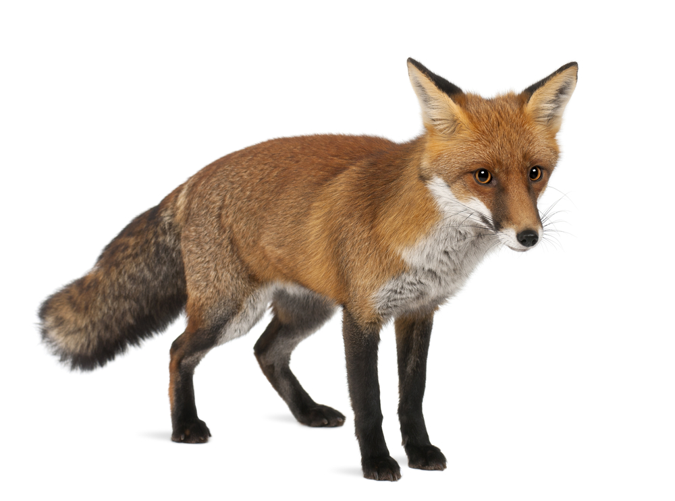
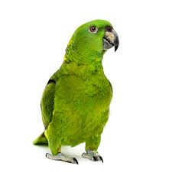

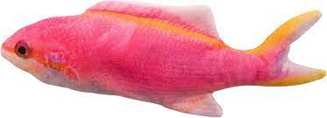
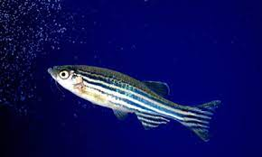
Why do we need model selection for clustering?

Slide 6
Why do we need model selection for clustering?

Slide 7
Why do we need model selection for clustering?

Slide 8
Why do we need model selection for clustering?

Slide 9
Why do we need model selection for clustering?

Slide 10
Why do we need model selection for clustering?

Slide 11
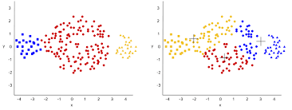
Why do we need model selection for clustering?
Group similar objects together
Constraints on clusters
Understand the structure of a dataset
The best clustering model will best describe the structure of the data.

Slide 12
Examples of clustering algorithms
Cluster numbers can be explicitly specified:
K-means
Gaussian Mixture Model (GMM)
Or inferred:
Hierarchical clustering
Louvain Clustering

Slide 13
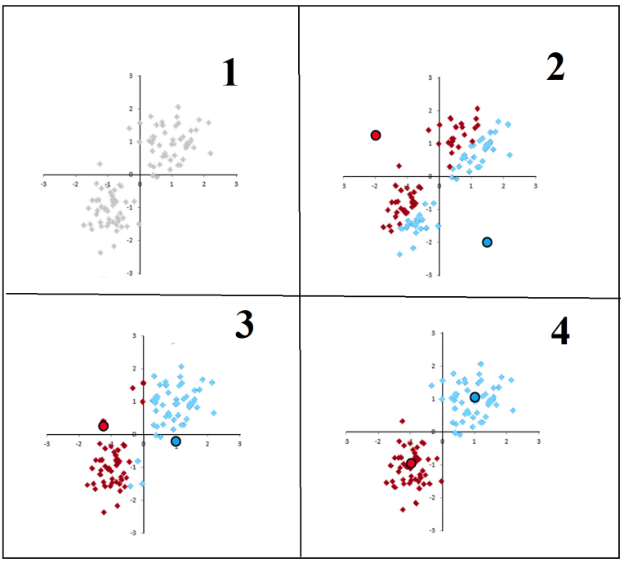
K-means
Choose k random points
Partition objects into k subset
Compute the new centroids (mean points) of the clusters
Repeat steps 2+3 until convergence

Slide 14
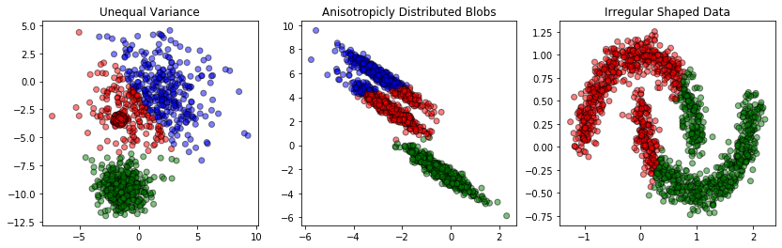
K-means

Slide 15
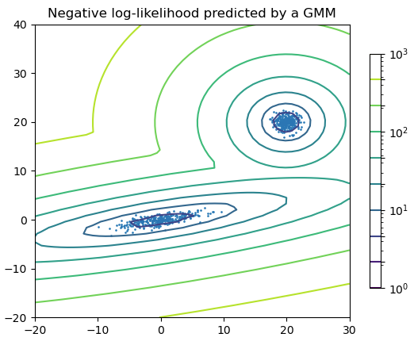
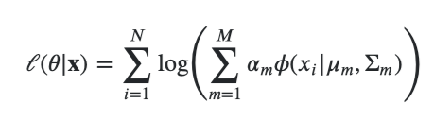
Gaussian Mixture Model (GMM)
k-means only considers mean points
GMM considers mean and (co-)variance
Fit M Gaussian components by maximising log-likelihood
x – datapoint
𝜽 - gaussian parameters {(μ_{m}, Σ_{m}): 0≤m≤M}
α - mixing coefficient
Φ – probability density function

Slide 16
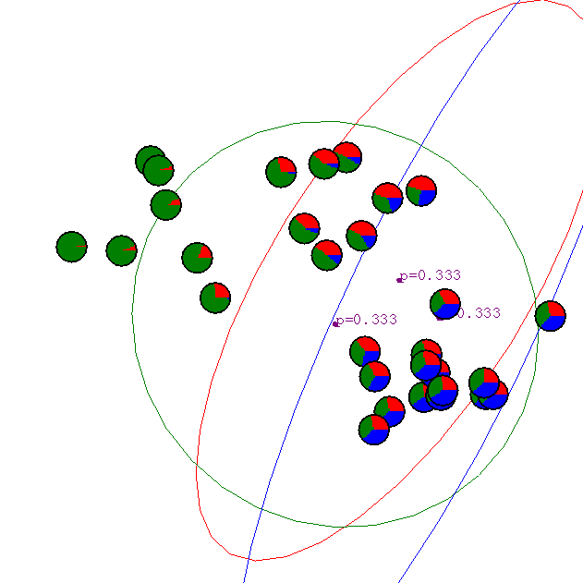
Initial Random Guess
Image credit Prof A Moore, Carnegie Mellon University

Slide 17
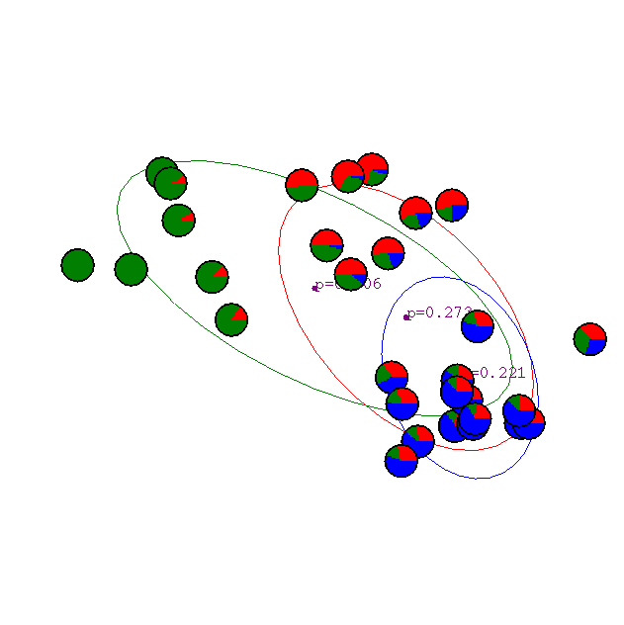
1st Iteration
Image credit Prof A Moore, Carnegie Mellon University

Slide 18

2nd Iteration
Image credit Prof A Moore, Carnegie Mellon University

Slide 19

3rd Iteration
Image credit Prof A Moore, Carnegie Mellon University

Slide 20

4th Iteration
Image credit Prof A Moore, Carnegie Mellon University

Slide 21

5th Iteration
Image credit Prof A Moore, Carnegie Mellon University

Slide 22

6th Iteration…
Image credit Prof A Moore, Carnegie Mellon University

Slide 23

…20th Iteration
Image credit Prof A Moore, Carnegie Mellon University

Slide 24
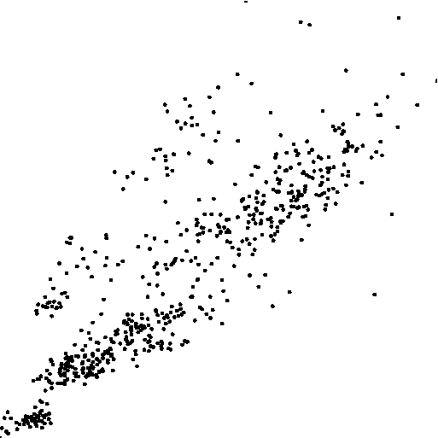
Gaussian Mixture Model (GMM)
Bio Assay Data
Image credit Prof A Moore, Carnegie Mellon University

Slide 25
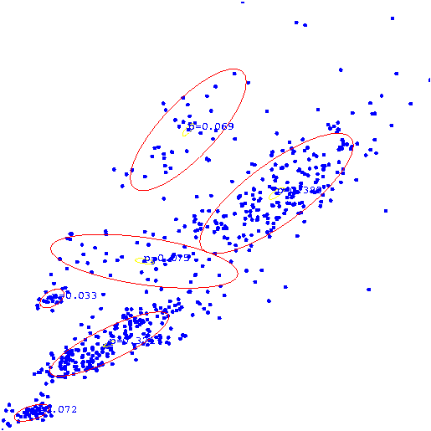
Gaussian Mixture Model (GMM)
Bio Assay Data
Image credit Prof A Moore, Carnegie Mellon University

Slide 26

Gaussian Mixture Model (GMM)
Bio Assay Data
Image credit Prof A Moore, Carnegie Mellon University

Slide 27
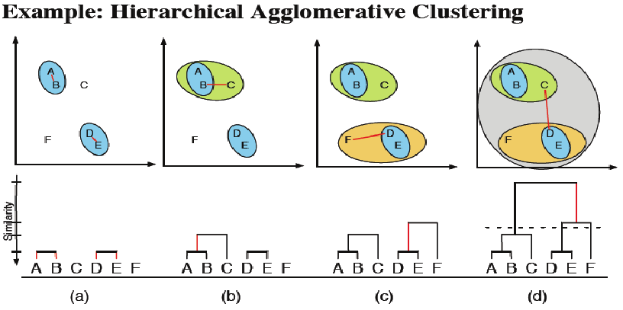
Hierarchical Clustering (HC)
Consider each data point as separate cluster.
Consecutively merge clusters until all clusters are connected or specified number of clusters are obtained.
Dendrograms illustrate distance between clusters.
No assumption on number of clusters

Slide 28
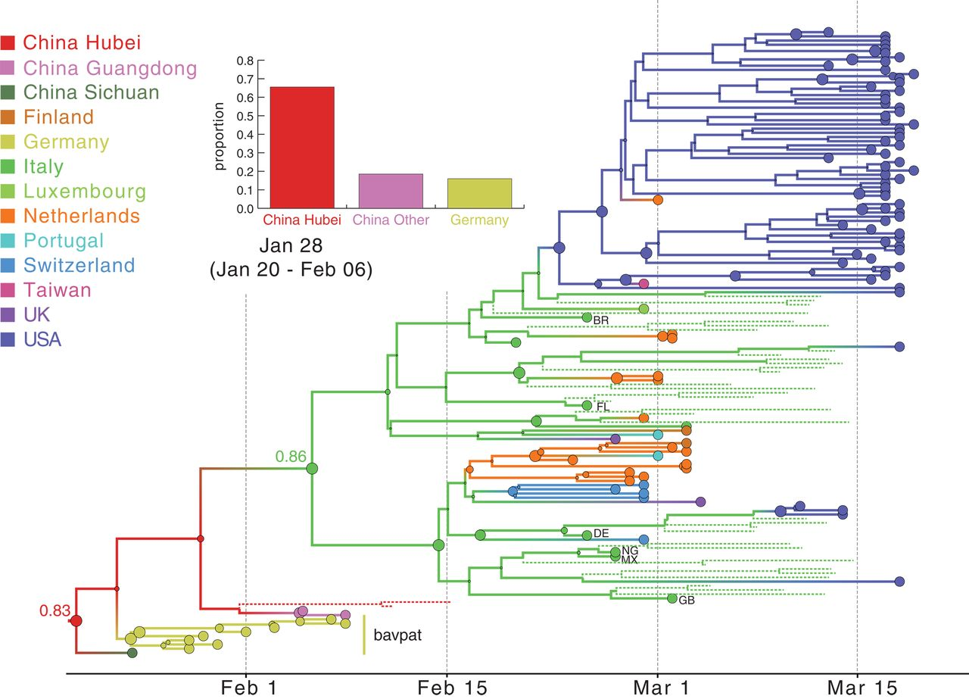
Hierarchical Clustering (HC)
DOI: 10.1126/science.abc8169

Slide 29
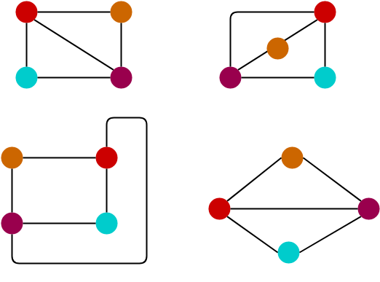
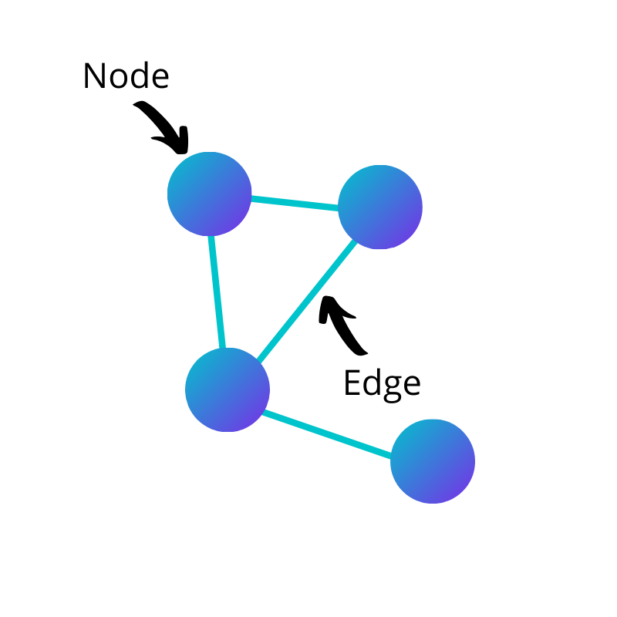
Graph Theory

Slide 30
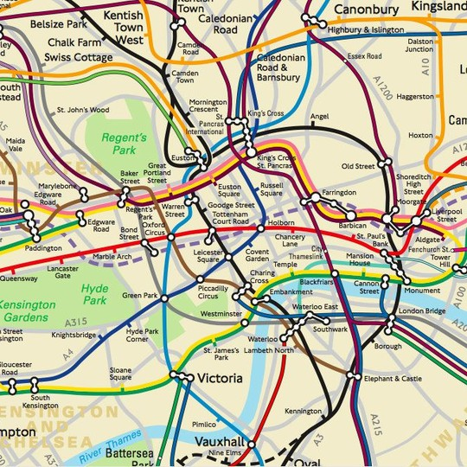
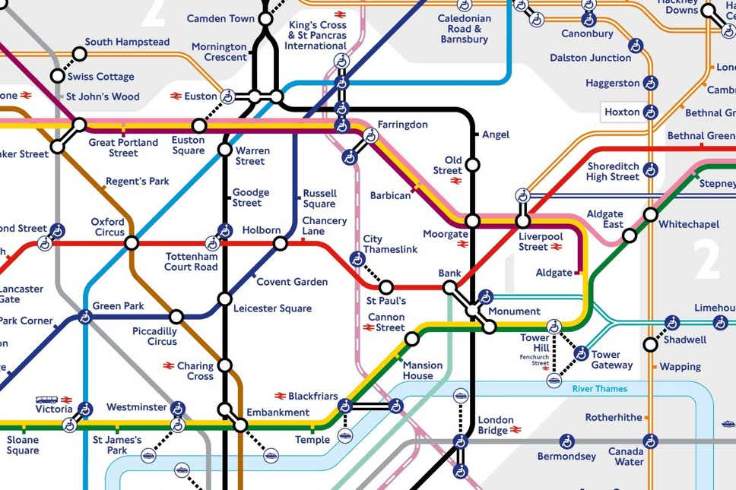
Making Sense of Arbitrary Shapes

Slide 31
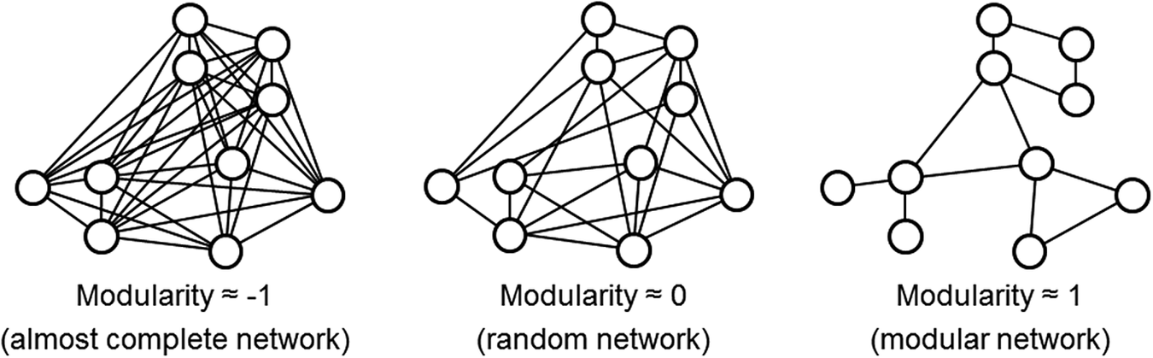
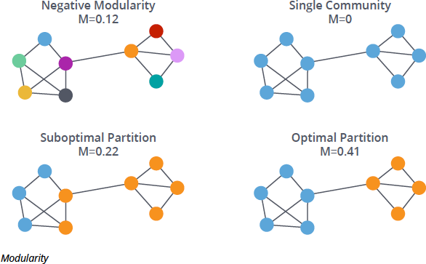
Graph-based clustering

Slide 32
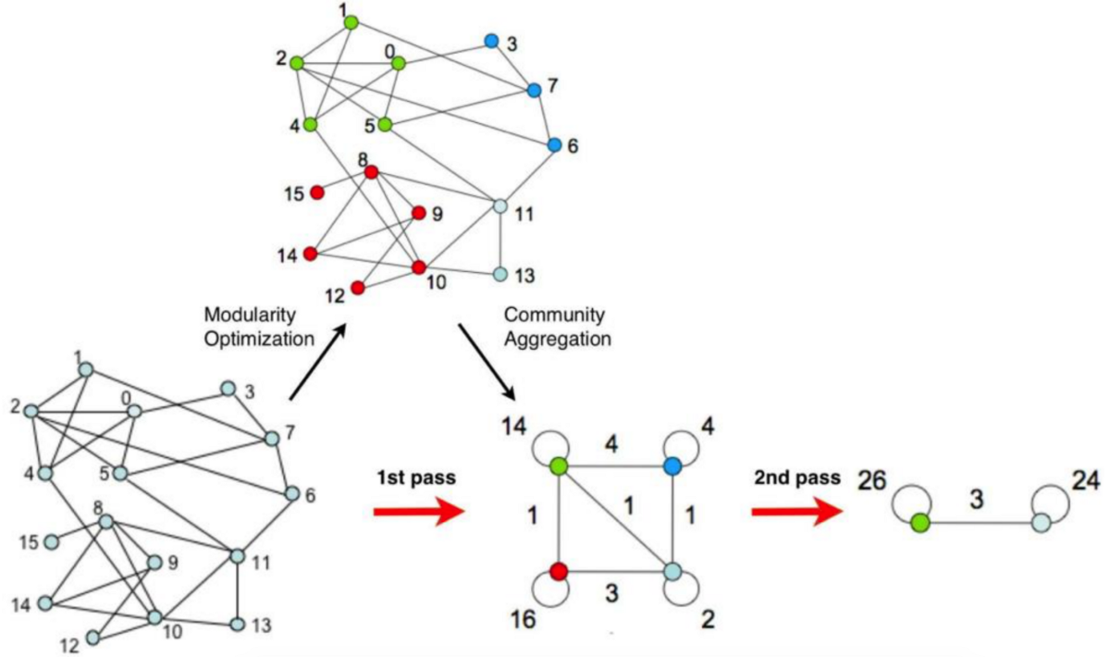
Louvain Clustering
Each data point represented as a node
Similarity between two data points represented by an edge
Assign nodes to different clusters by Modularity
Clusters repeatedly combined until no improvement in modularity
Resolution parameter in modularity function determines number of clusters.

Slide 33
What make model selection for clustering challenging?
No labels
Outcomes are subjective
Hard to define model performance (cluster quality)
Sensitive to different clustering algorithms and different feature spaces
How do we evaluate then?

Slide 34
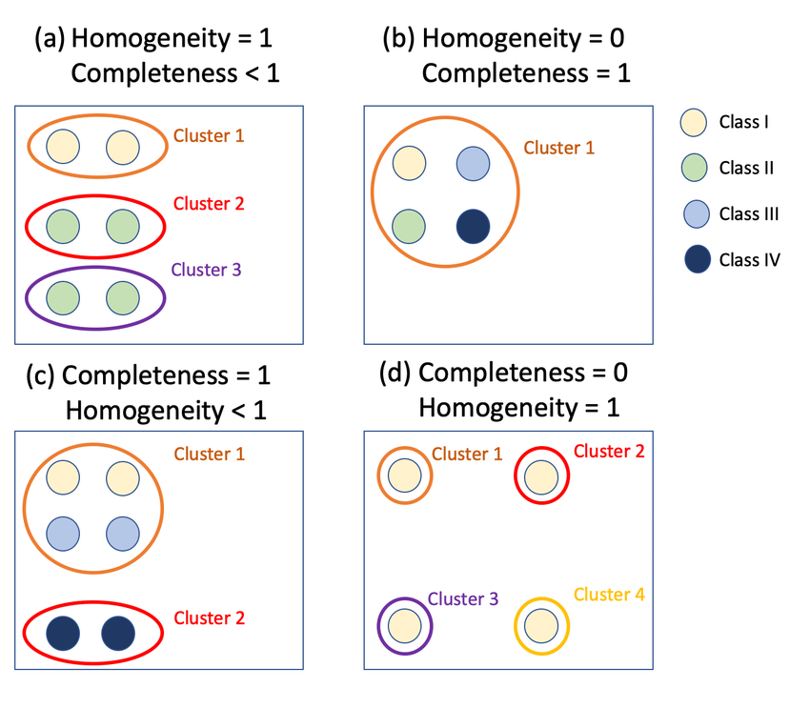
V-measure
Given ground truth labels: Use them!
homogeneity: each cluster contains only members of a single class
completeness: members of a given class are assigned to the same cluster
V-measure is the average (harmonic mean) of the two metrics

Slide 35
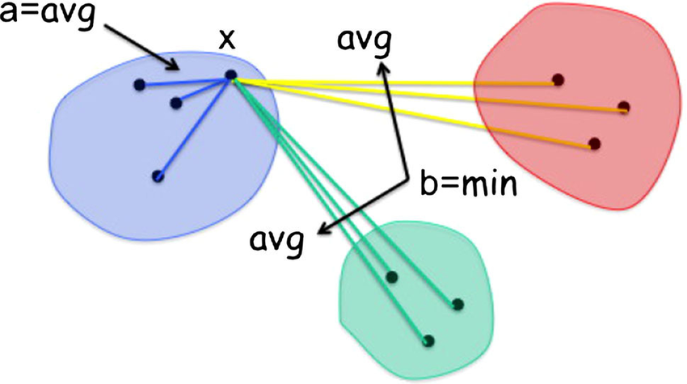
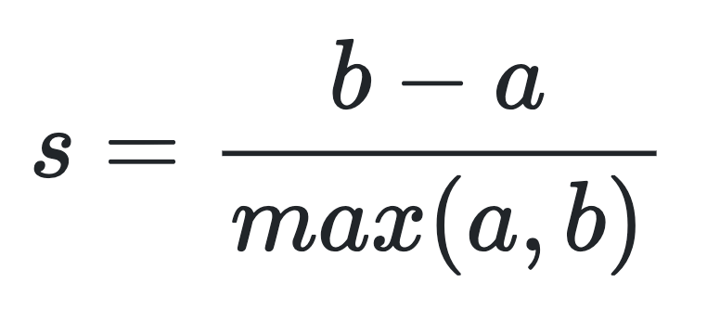
Silhouette Score
If the ground truth labels are not known:
Evaluate on structure
-1: incorrect clustering
≈0: overlapping clusters.
+1: highly dense clustering
Higher score means clusters are dense and well separated
Mean distance between a sample and all other points in the same class
The mean distance between a sample and all other points in the next nearest cluster

Slide 36
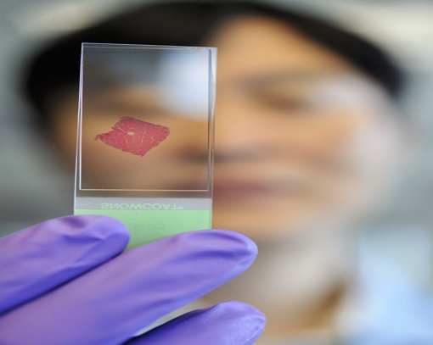
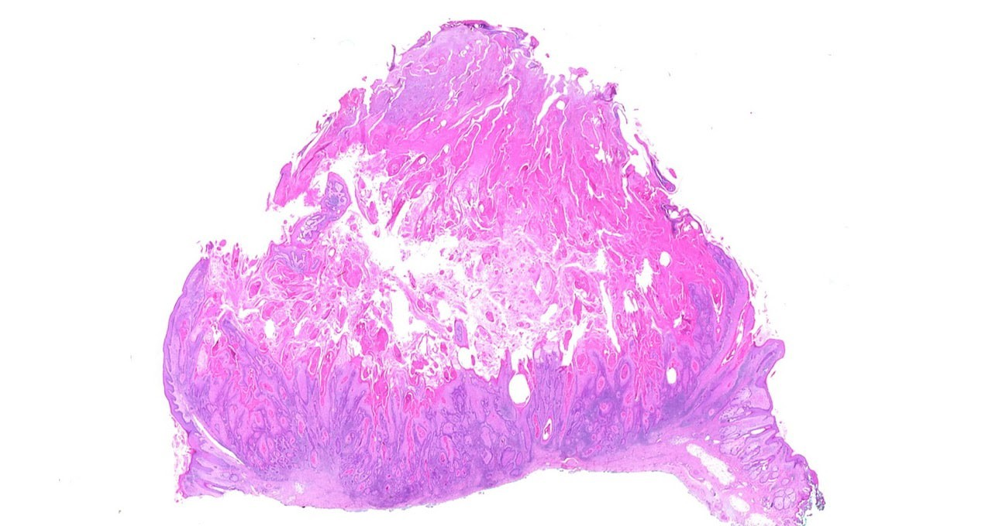
Introduction to digital pathology
Cancer diagnosed by biopsy
Removed tissue analysed under digital microscope
20Gb on average ~100000x100000 pixels

Slide 37
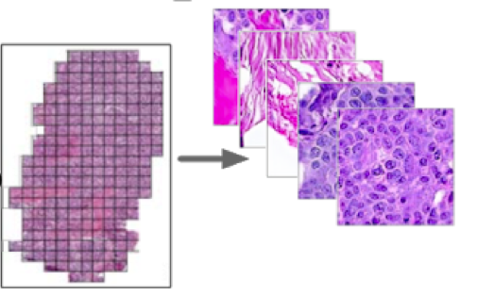

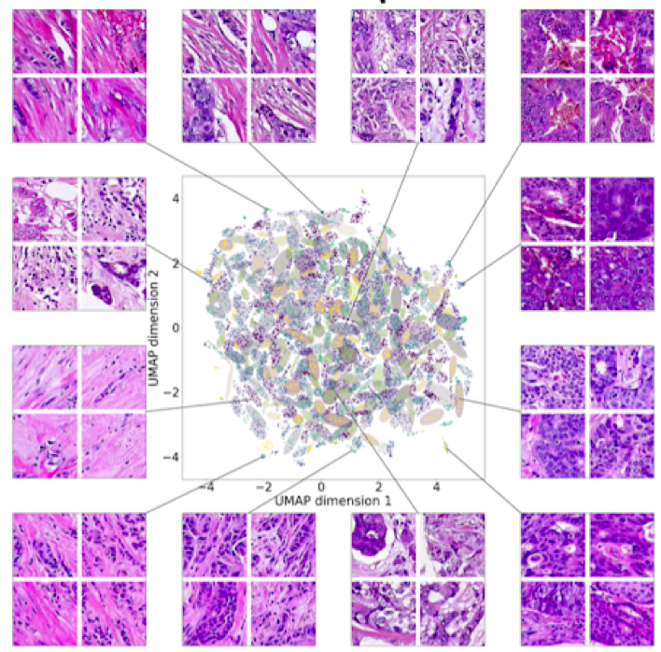
Image Processing
Split whole slide image into patches
Break whole slide images (WSIs) into small patches
(Dimensionality reduction/feature extraction)
Cluster tissue patches
Clustering gives statistical summary of visual features
Group similar patches into the same clusters

Slide 38
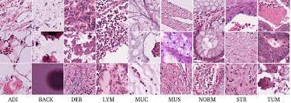
Your task: model selection for tissue patch clustering
Dataset:
5,000 colorectal cancer tissue patches.
9 tissue types:
Adipose (ADI)
background (BACK)
debris (DEB)
lymphocytes (LYM)
mucus (MUC)
smooth muscle (MUS)
normal colon mucosa (NORM)
cancer-associated stroma (STR)
colorectal adenocarcinoma epithelium (TUM)
Your task
Select appropriate clustering algorithms (Kmeans, GMM, HC, and Louvain, or HDBScan, Leiden or any other algorithm)
Apply to a cancer dataset
Assess model performance (Silhouette score/V measure)

Slide 39
Feature extraction and preprocessing has been done for you
5,000 images (244x244x3)
PathologyGAN:
state-of-the-art model for tissue images
Trained on unlabelled data
ResNet50/InceptionV3/VGG16:
Popular CNN classifiers
Trained on ImageNet dataset and achieve 74.9%, 77.9%, 71.3% accuracy
Dimensionality reduction methods reduce each representation size to 100
PCA: the first 100 PCs with highest variance are obtained
UMAP: 100 umap components
PathologyGAN
ResNet50
InceptionV3
VGG16
5000 vectors of 200 dimension
5000 vectors of 2048 dimension
5000 vectors of 2048 dimension
5000 vectors of 4096 dimension
PCA
UMAP
PCA
UMAP
PCA
UMAP
PCA
UMAP
2 x 5000 of 100-d vectors
2 x 5000 of 100-d vectors
2 x 5000 of 100-d vectors
2 x 5000 of 100-d vectors
pge_dim_reduced_feature.h5
resnet50_dim_reduced_feature.h5
inceptionv3_dim_reduced_feature.h5
vgg16_dim_reduced_feature.h5

Slide 40
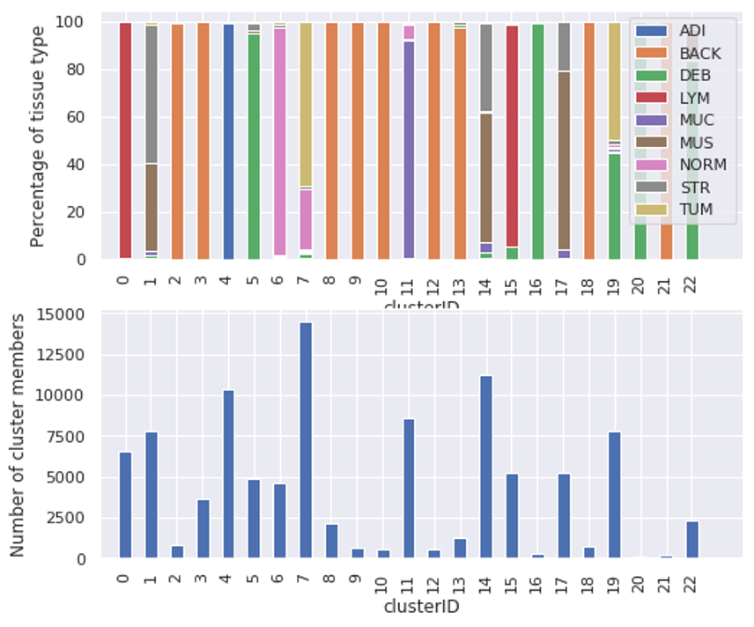
Example of cluster performance report
Measure A
Representation | Kmeans | GMM | DBScan | Louvain
PathologyGAN | ? | ? | ? | ?
ResNet50 | ? | ? | ? | ?
InceptionV3 | ? | ? | ? | ?
VGG16 | ? | ? | ? | ?
Tissue Abundance Percentage
Cluster ID

Slide 41
Report summary
Objective: test clustering algorithms and evaluate performance on real data
Include in your report:
Introduction
Clustering/background/data
Methodology:
Theory and intuition behind each algorithm and representation
Experimental framework:
Parameter searching and evaluation
Results
Report and discuss cluster qualities according to both qualitative and quantitative measures
Conclusion

Slide 42
Summary of Methods
K-means
Fast, simple, guaranteed convergence, scales well with dataset size
Manual number of clusters, sensitive to outliers, scales badly with dimensions
Gaussian Mixture Model
Handles outliers, more informative, guaranteed convergence
Slow, same issues as k-means, computation time scales badly with dataset size
Hierarchical Clustering
Simple, guaranteed convergence, scales well, no predetermined number of clusters, gives different resolutions of clustering
Slow, limited meaningful clustering, can infer artificial relationships
Louvain Community Detection
Handles outliers, more informative, scales well with dataset size and dimension, no assumption on shape
Computationally intensive for small datasets, pre-determined resolution

Slide 43
Summary
Model Selection
What does best mean?
Consider what outcomes are most important
Clustering
Different models give very different results
Use prior knowledge to select appropriate model
Evaluate clusters based on structure or labels

